Slide 1
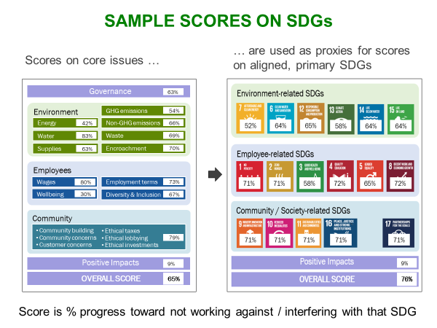
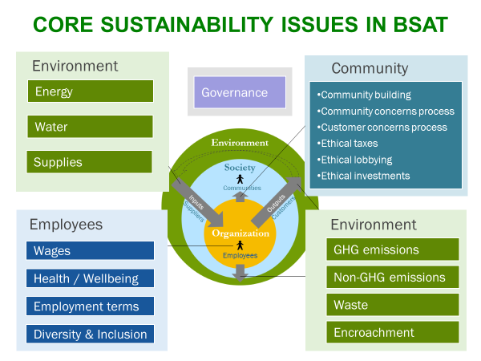
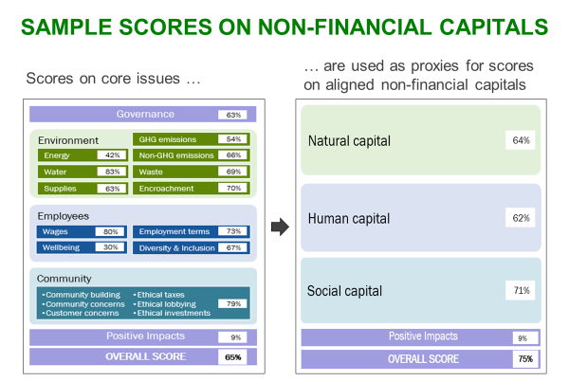
Basic Sustainability Assessment Tool (BSAT) mapped to the B Impact Assessment (BIA) V6
Basic Sustainability Assessment Tool
This free, open-source, comprehensive, generic tool can be used by any-size organization, in any sector, in any country. It score the organization on core sustainability issues, on its contributions to the 17 SDGs, and on its impacts on natural, human, and social capitals.
sustainabilityadvantage.com/assessments/tools/

Slide 2
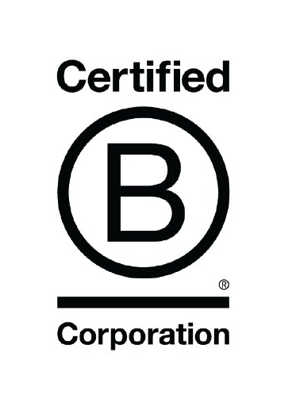
Science-Based F2B2 Goals Align with B Corp BIA Goals and IBMs
How the BSAT Performance topics and Positive Impacts map to the B Corp BIA Operational topics and Impact Business Models
BSAT Performance scores Scores (0-100%) on these performance questions = Progress on not causing harm in that issue area
BSAT Positive Impacts
Being regenerative on an environmental or social issue, either directly or indirectly, through products, services and donations
5 Operational Impact Areas in the BIA, for all businesses
24 Impact Business Models (IBMs) from which businesses choose the best match
Energy: How much energy is from renewable sources.
Air & climate
Renewable or cleaner-burning energy
The organization’s products and services (P/S) help customers, and its donations help the underserved, be restorative / regenerative on these issues:
Energy: Use energy significantly more efficiently, or use low-impact renewable energy
Water: Use water significantly more efficiently, or have access to clean water and sanitation
GHGs: Emit significantly fewer GHGs, or remove GHGs from the atmosphere
Non-GHGs: Generate fewer non-GHG harmful emissions, or remove them from air, land, or soil
Waste: Generate significantly less waste, repurpose more waste, or remove waste from the environment
Encroachment: Protect or restore terrestrial or marine ecosystems, or cultural heritage sites
GHGs: How much Scope 1 and 2 emissions were reduced from a baseline year; identification of relevant sources of Scope 3 emissions.
Water
Resource conservation
Water: How much water is from unstressed water regions, and is safely treated when discharged.
Land / wildlife conservation
Land & life
Toxin reduction / remediation
Environmental management
Environmental education & information
Waste: How much operational, product and packaging non-hazardous waste is repurposed, and how much hazardous waste is properly disposed of.
Environmentally innovative production
Non-GHG emissions: How much solid, liquid and gaseous emissions cause no harm.
Legend - Colors of Impact Areas Governance
Workers
Community
Environment
Customers
P/S: Products and / or services
ESOP: Employee stock ownership plan
EM only: Only applies in emerging markets
DM only: Only applies in developed markets
Encroachment: How many sites do not encroach on ecosystems or communities.
Worker owned business (e.g. cooperatives & ESOPs)
P/S provide income generating activities and economic empowerment for underserved individuals
Employees: How many employees are paid at least a living wage.
Financial security: Living wage; bonuses; worker ownership & ESOPs; retirement plan
P/S provide health and wellness improvement for all
P/S enhance the education, skills and knowledge of all
Employee health: How many workplace injuries and fatalities occurred.
Health, wellness & safety: Healthcare plans; wellness programs; occupat’l health & safety
P/S provide financial or operational support for underserved / purpose driven enterprises
Employee terms: How many fair employment terms, aligned with human rights, are included in employment contracts.
Career development: Internal promotions; job & life skills training; performance reviews; severance / termination policies
P/S provide drive social and environmental impact improvement in customer organizations
P/S promote or preserve arts, culture or journalism / media
Employee concerns: The process for handling employee concerns is robust and trusted.
Engagement & satisfaction: Handbook; flexibility; flex / leave policies; worker voice; attrition; certifications
P/S build infrastructure and market access for communities that were previously inaccessible (EM only)
Employee diversity, equity and inclusion (DEI): Policies on diversity include anti-discrimination and pay equity policies.
Basic services for the underserved
Diversity, equity and inclusion
Serving underserved populations
Supplies: How much sustainable procurement is used to procure the most sustainable goods and services from the most sustainable suppliers.
Workforce development by providing jobs and job training for chronically underemployed populations
Supply chain management
Supply chain poverty alleviation through trade terms, positive labor conditions and support for underserved
The organization’s products and services (P/S) help customers, and its donations help the equity-deserving, have the capacity and opportunity to:
Meet their basic needs
Live healthier and safer lives
Live more empowered, self-supportive and informed lives
Community
Community building
Ethical handling of community concerns
Ethical handling of customer concerns
Ethical payment of taxes
Ethical lobbying
Ethical investments
Economic impact
Micro-franchise poverty alleviation by providing micro-entrepreneurship franchise opportunities for the underserved
Civic engagement & giving
Local economic development through local procurement, ownership, banking, customers and charitable giving (DM only)
Customer stewardship: Quality assurance; warranties; accreditations & certifications
Micro-distribution poverty alleviation thru opportunities for micro-entrepreneurship product distribution by the underserved
Ethics & Transparency: Board oversight; stakeholder voice; codes, policies & controls; training; impact reporting; financial, tax, and lobbying transparency
National economic development by promoting privatization or import substitution in underdeveloped markets (EM only)
Producer cooperative approach to production, decision making and profit distribution
Mission & Measurement: Focus & mission; ESG performance & compensation plans, board oversight; material ESG goals, targets & reporting; stakeholder engagement
Designed to give significant portions of company profits, revenue, equity, or time to charitable causes
Governance: Degree to which sustainability considerations are embedded in governance and management systems.
Mission locked: Corporate form preserves mission and/or considers all stakeholders, regardless of company ownership

